Slide 1
Lecture 12 Graph
Abrar Hasan
Lecturer
Dept. of Software Engineering
Daffodil International University

Slide 2
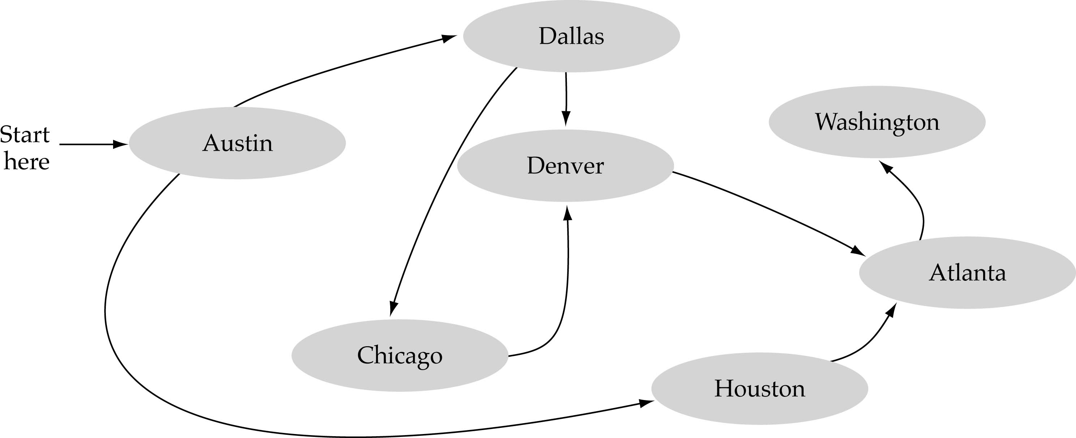
What is a graph?
A data structure that consists of a set of nodes (vertices) and a set of edges that relate the nodes to each other
The set of edges describes relationships among the vertices

Slide 3
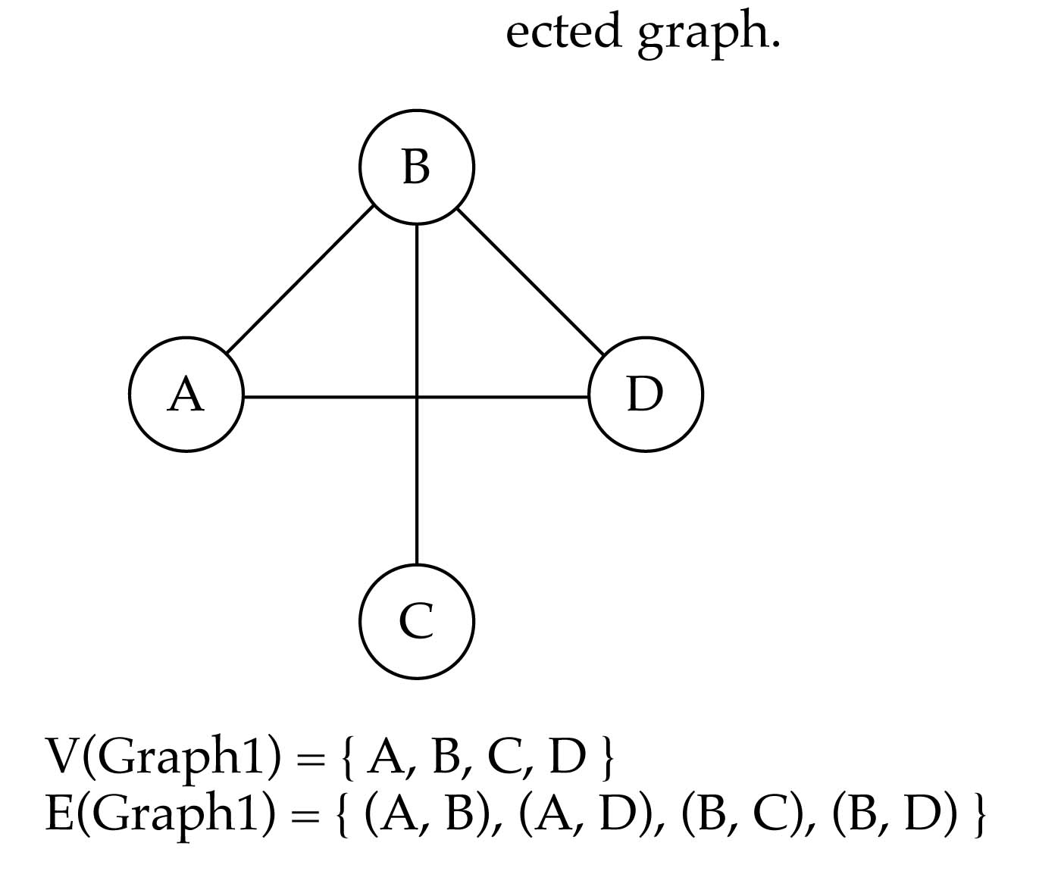
Undirected graphs
When the edges in a graph have no direction, the graph is called undirected

Slide 4
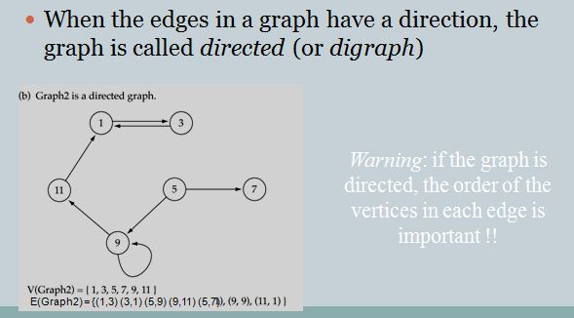
Directed Graph

Slide 5
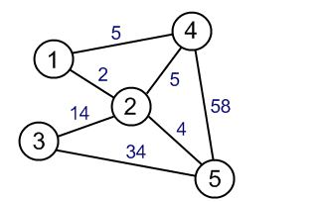
Weighted graphs
Here we have the following parts.
The underlying set for the Vertices set is Integer.
The underlying set for the weights is Integer.
The Vertices set = {1,2,3,4,5}
The Edge set = {(1,4,5) ,(4,5,58) ,(3,5,34) ,(2,4,5) ,(2,5,4) ,(3,2,14) ,(1,2,2)}

Slide 6
Graph Representation
Vertices can be represent as one dimensional array.
Graph edges are commonly represented in two ways:
1. Adjacency Matrix
An adjacency matrix is 2D array of V x V vertices. Each row and column represent a vertex.
If the value of any element a[i][j] is 1, it represents that there is an edge connecting vertex i and vertex j.

Slide 7
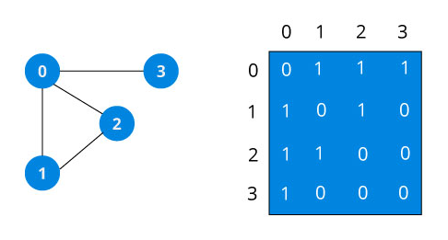
Adjacency Matrix Example
Since it is an undirected graph, for edge (0,2), we also need to mark edge (2,0); making the adjacency matrix symmetric about the diagonal. Edge lookup(checking if an edge exists between vertex A and vertex B) is extremely fast in adjacency matrix representation but we have to reserve space for every possible link between all vertices(V x V), so it requires more space.

Slide 8
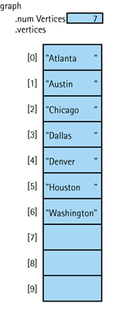
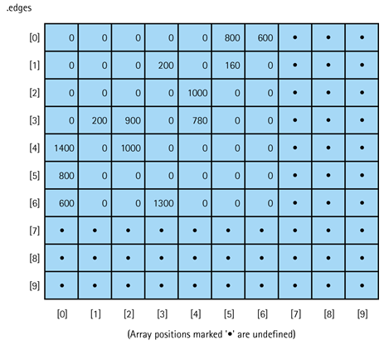
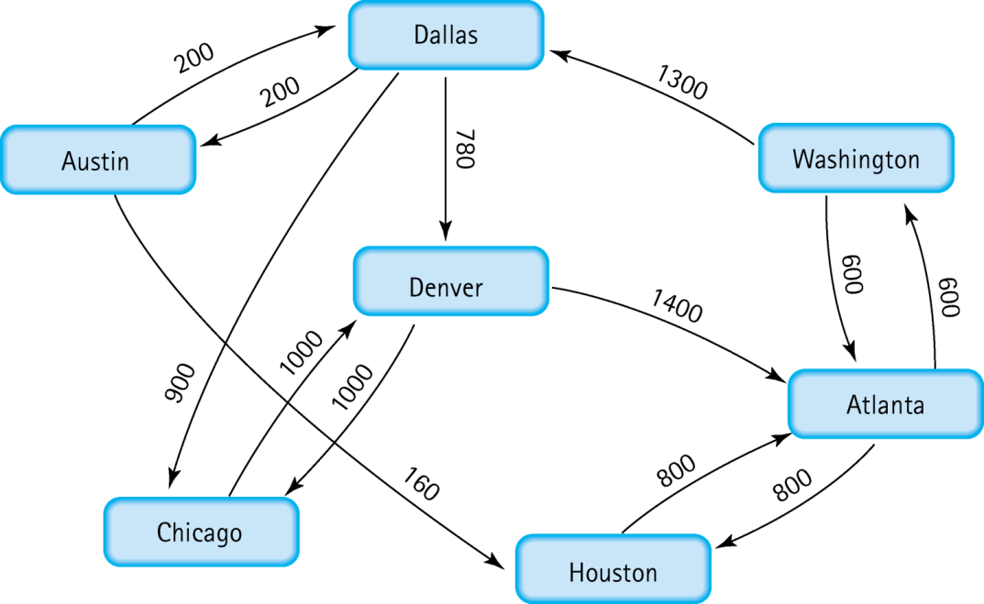
Adjacency Matrix for Flight Connections

Slide 9
2. Adjacency List
Adjacency list is a collection of unordered lists used to represent a finite graph.

Slide 10
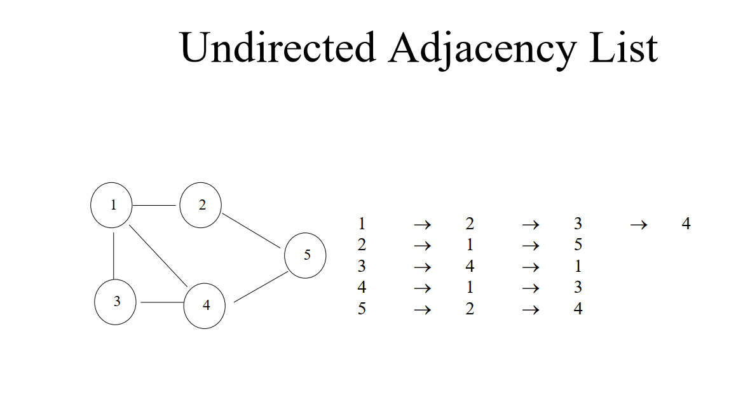

Slide 11
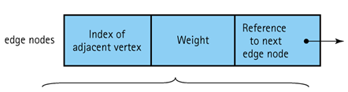
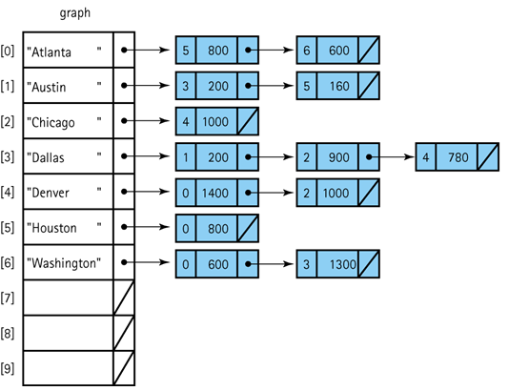
Adjacency List Representation of Graphs

Slide 12
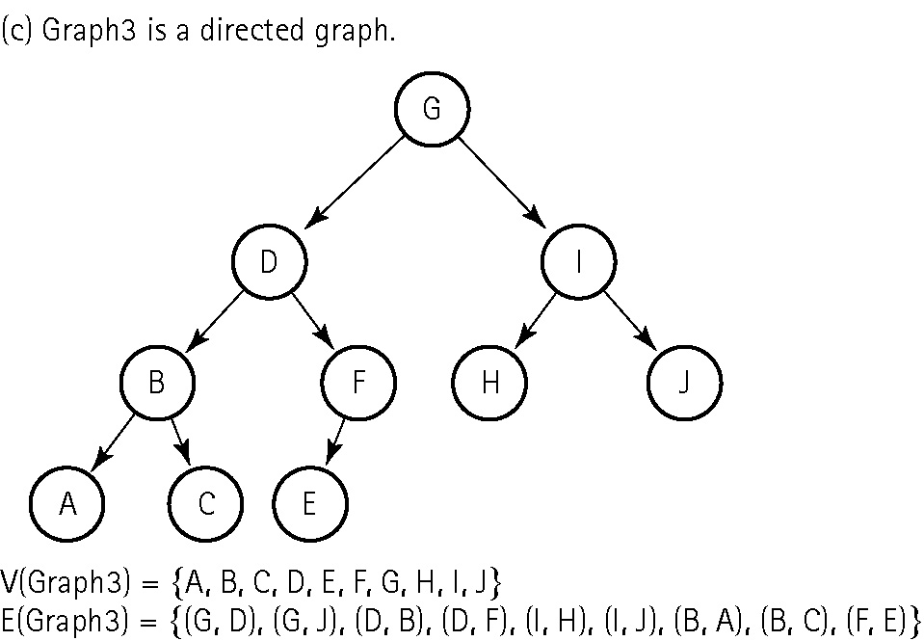
Trees are special cases of graphs!

Slide 13
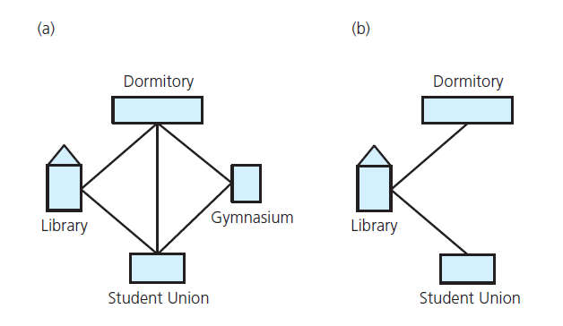
Terminology
(a) A campus map as a graph; (b) a subgraph

Slide 14
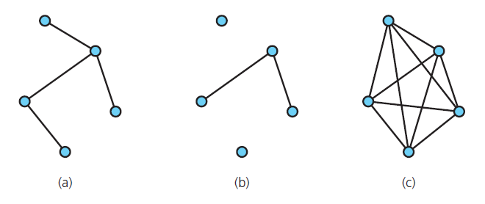
Terminology
Graphs that are (a) connected; (b) disconnected; and (c) complete

Slide 15
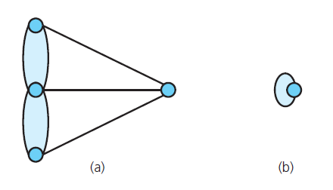
Terminology
(a) A multigraph is not a simple graph; (b) a self edge is not allowed in a simple graph

Slide 16
Graph terminology
Path: A sequence of vertices that connects two nodes in a graph
The length of a path is the number of edges in the path.
1
2
e.g., a path from 1 to 4
<1, 2, 3, 4>
3
4

Slide 17
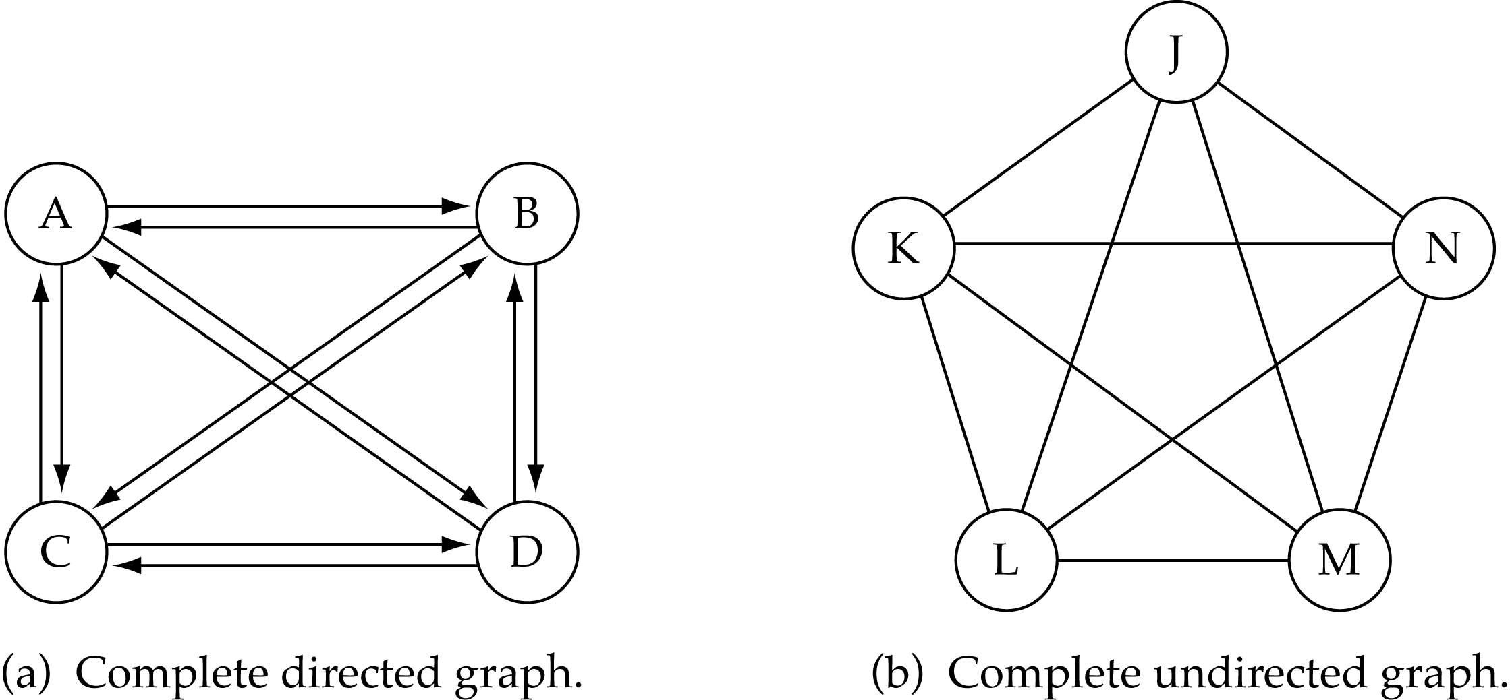
Graph terminology
Complete graph: A graph in which every vertex is directly connected to every other vertex

Slide 18
Graph Implementation
Directed Graph:
https://www.techiedelight.com/implement-graph-data-structure-c/
Undirected graph:
https://www.geeksforgeeks.org/graph-and-its-representations/

Slide 19
Thank You

